Slide 1
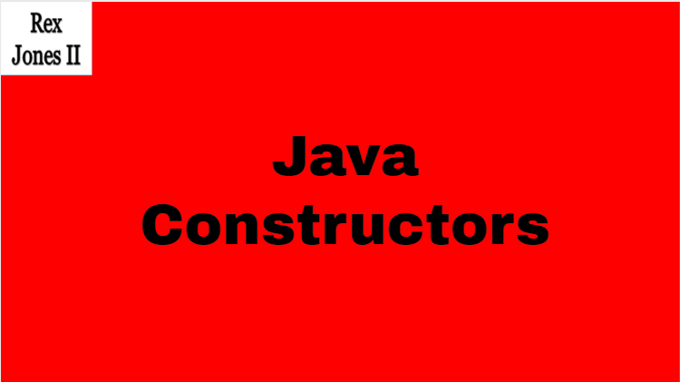

Slide 2
Default
Constructors

Slide 3
Parameterized
Constructors

